Slide 1
Cloud Pak for Business Automation Operational Decision Manager

Slide 2
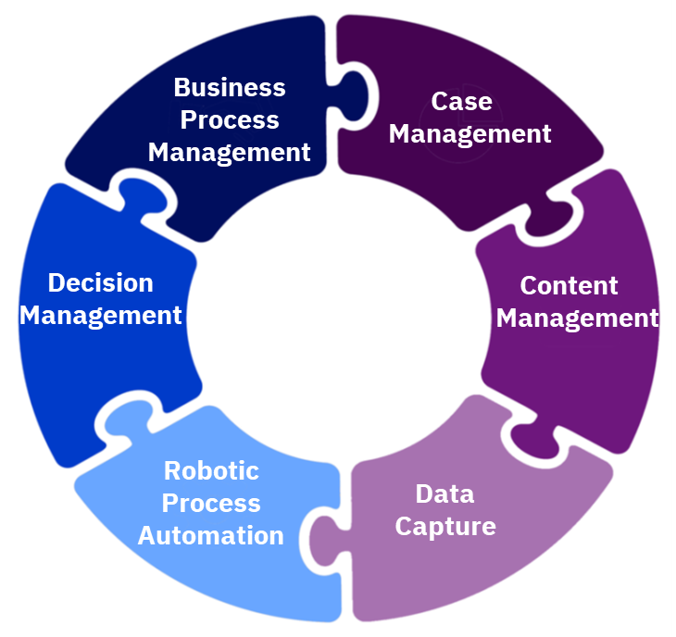
Why decisions management?
Decisions can be owned by business stakeholder
Decisions are consistent across the organization
It’s easier and faster to improve and keep decisions up to date
Complex business decisions execution are fully automated
ODM capabilities
Develop, manage, and govern business decision services
Perform inferences, validations, calculations
Perform decision testing and simulation
Create natural language rules and decision tables

Slide 3
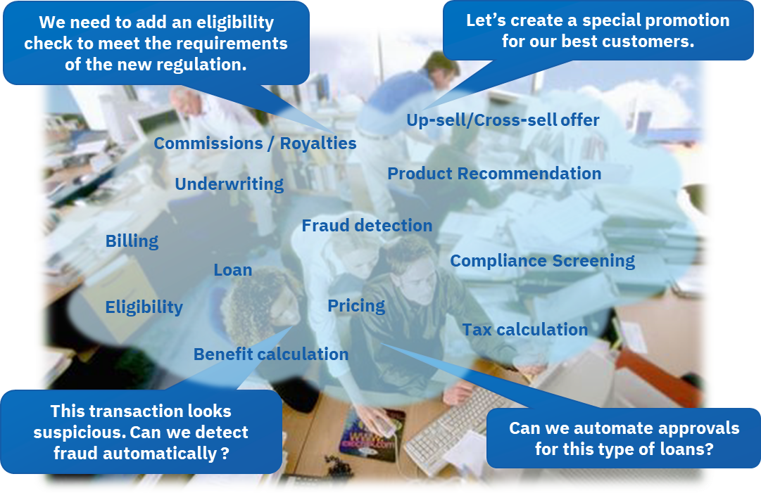
Decisions can be found in every business process…
And they keep changing…

Slide 4
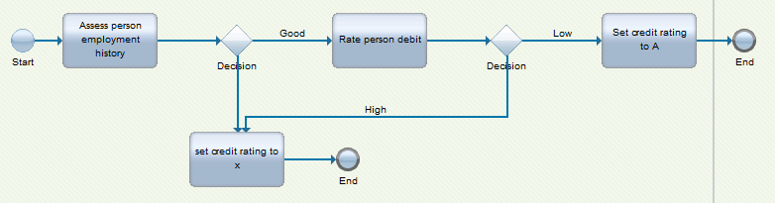


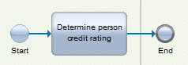
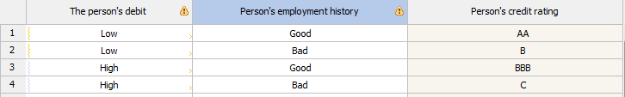
Workflow using decisions
Implement decision service in ODM and invoke it as REST service from a workflow
Different life cycle, owners, governance
Easier maintenance and DevOps
debt
determine credit rating
employment history
rating

Slide 5
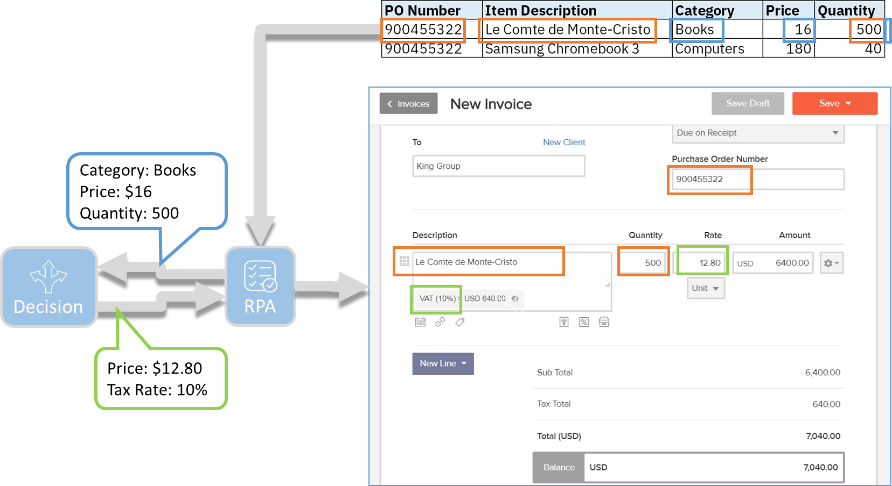
RPA bot using decisions
Enhance the autonomy of RPA Bots.
Allow to derive new data instead of just shuffling it around.
Integration can be done through the REST API or using a Decision Form UI.
orders
input
calculated
price and tax rate
invoicing application
Notes:
See https://www.ibm.com/support/knowledgecenter/SSMGNY_11.0.0/com.ibm.wbpm.rpa.main.doc/topics/odm_rpa.html

Slide 6

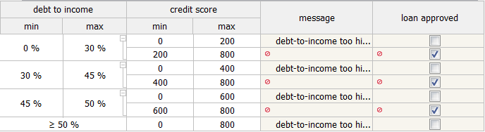
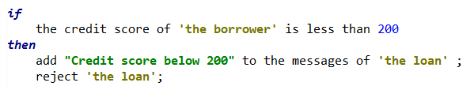
What are decision services?
Making a decision is the act of determining an outcome,
by applying specialized business knowledge,
in a given context
Context: Input, a number of data points or the outcome of other decisions
Business knowledge: Decision logic, organized as a set of business rules
Outcome: Output
determine applicant eligibility
Credit score
Yearly income
Eligible?
Loan amount
input
decision logic
output

Slide 7
Decision services benefits
Because the decision logic is centralized, decomposed and intelligible, decision services are:
Adaptable: you support fast and easy change in the business logic
Auditable: you can clearly demonstrate how a decision was made
Traceable: you can precisely map the requirements to the implementation
Reusable: you can share business logic across processes and applications
Manageable: you can govern and validate changes, as IT or Business
decision logic

Slide 8




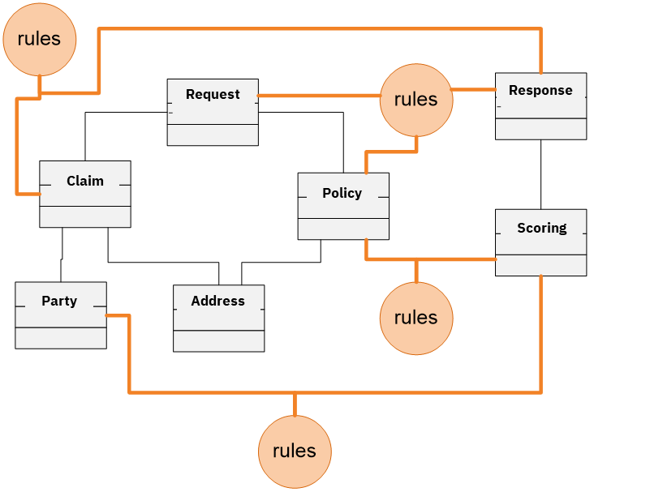
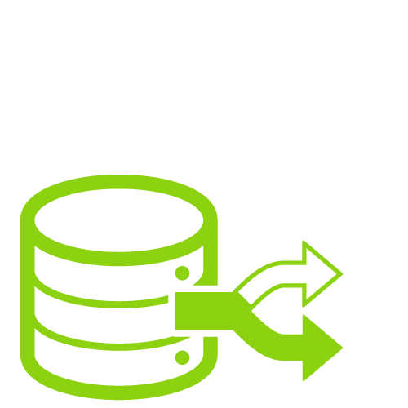
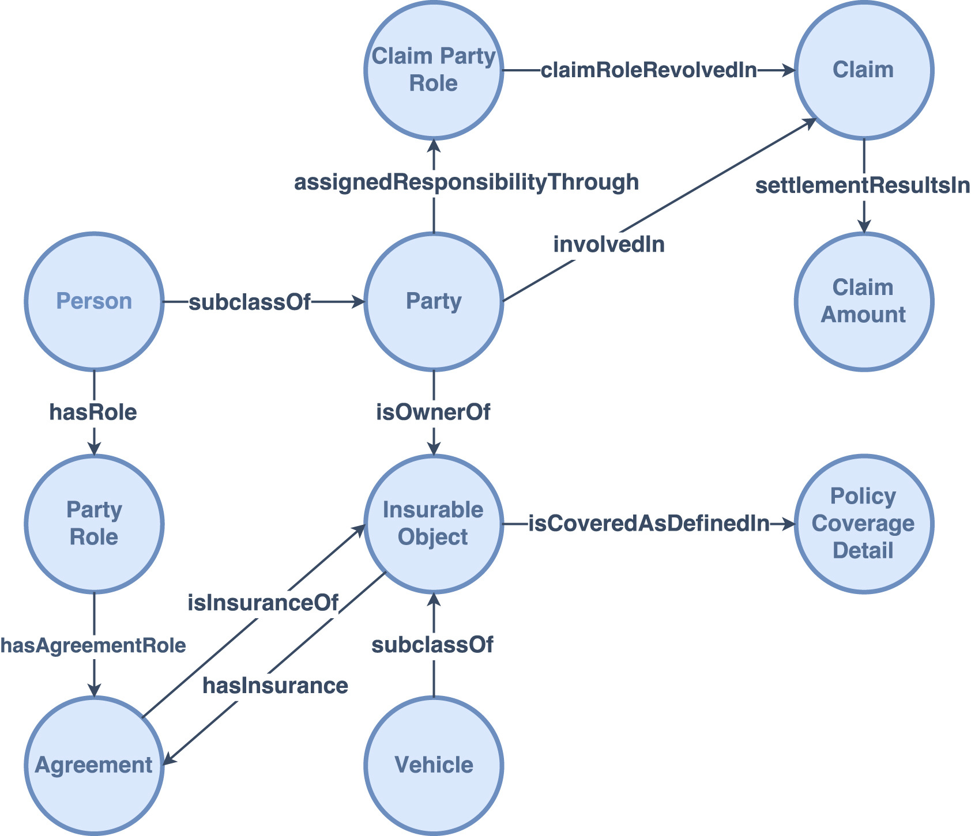

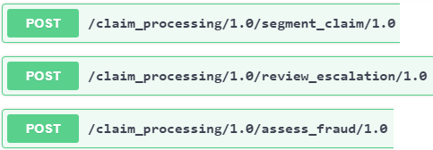
ODM in a nutshell
Operational Decision Manager
Technology
Business
Business
business decisions
View and maintain rules
Test decisions
Simulate change impact
Deploy updated decisions
Manage
Share
Client application
business concepts
Execute

Slide 9


ODM key components and roles
Define decision service
Architect
Developer
Rule Designer (Eclipse)
DESIGN
Maintain decision logic
Policy manager
Rule author
Decision Center
Business & Enterprise Console
Expose decision service
MANAGE
Administrator
Rule Execution Server
EXECUTE

Slide 10
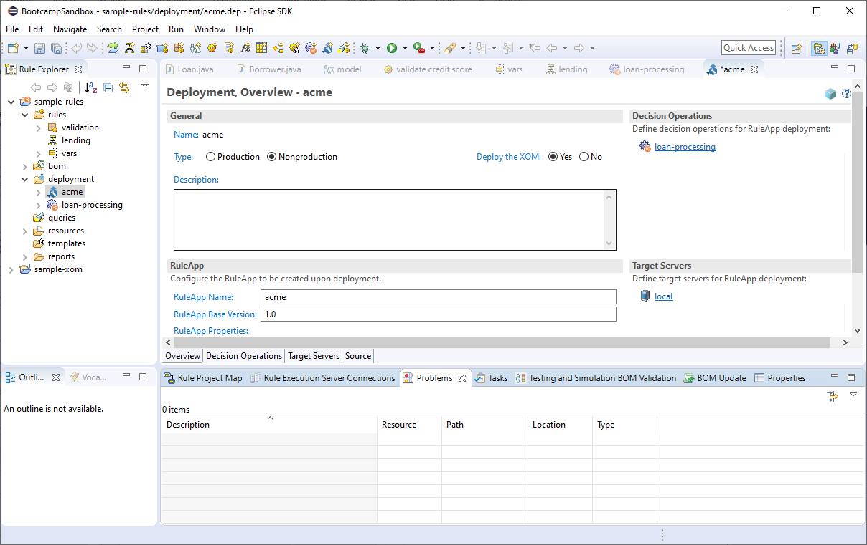
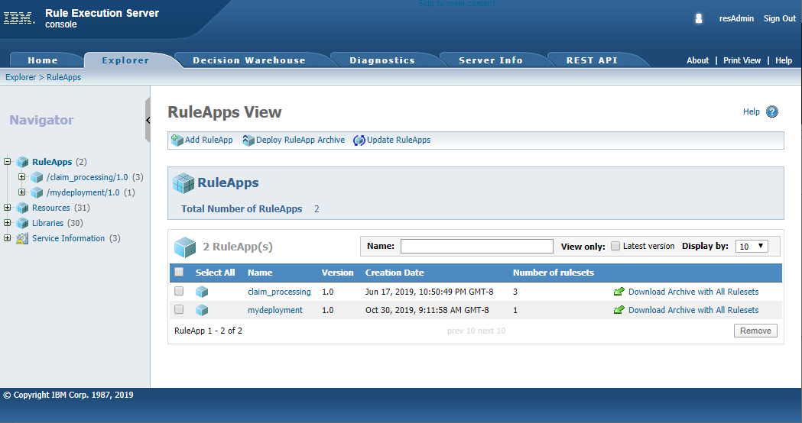
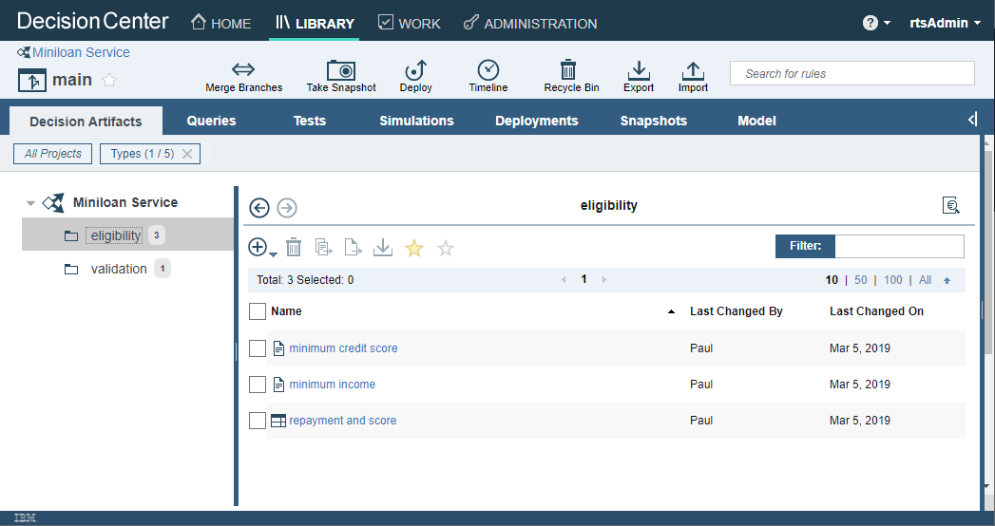
Live demo: build and deploy a decision service

Slide 11
Cloud Pak for Automation Bootcamp Hands-on lab! CP4BA ODM Lab - Loyalty.docx

Slide 12
Cloud Pak for Automation Bootcamp Lab solution review CP4BA ODM Lab - Loyalty.docx

Slide 13
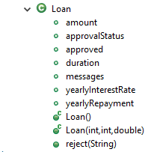
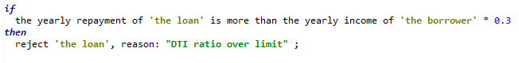
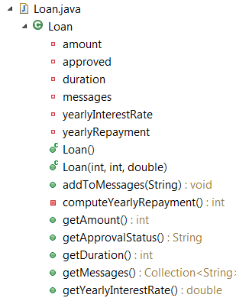
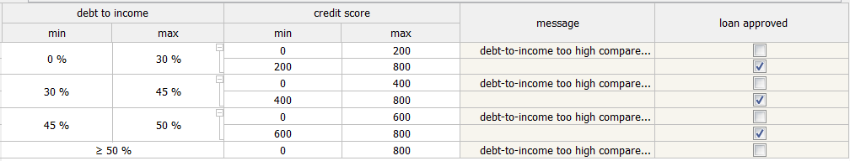
Essential rule artifacts
Business model
Execution model
Rule
Decision table

Slide 14
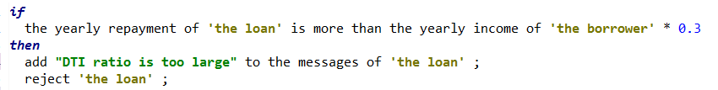
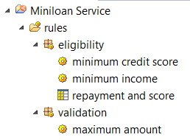
Folders organization
Action rule
Rule folders hierarchy
Decision table

Slide 15
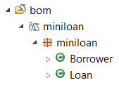
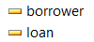
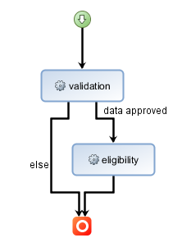
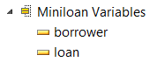
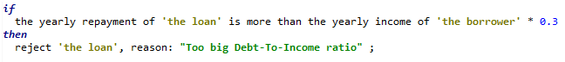
Key concept of operation
1
Model decision logic
decision service
2
Assemble decision operation
BOM
3
3
Deploy decision service
1
rule flow
4
Maintain decision service
2
variables
rules
decision operation
4
decision artifacts
decision repository

Slide 16
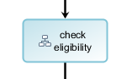
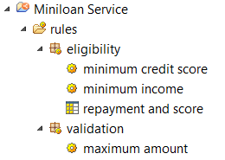
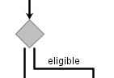
Rule flow
Business decision are decomposed in high-level tasks
Each task is realized by applying a number of business rules
Tasks are orchestrated with a rule flow
Sub-flow
Conditional branching

Slide 17
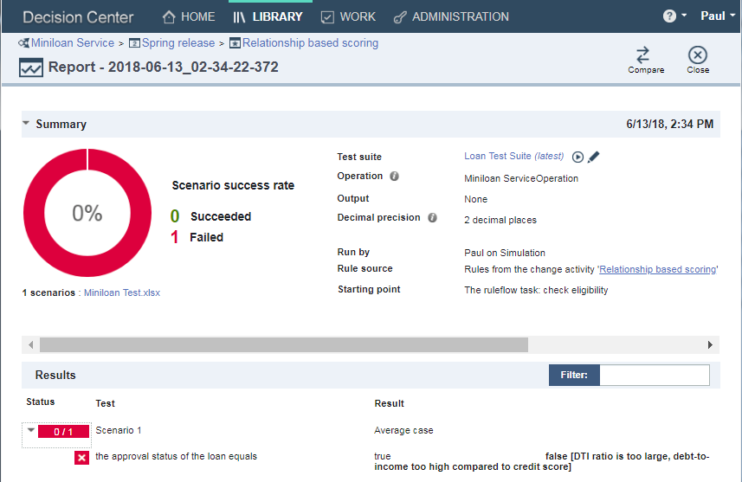
Functional validation for decisions (a.k.a testing)
Business users define test suites through Excel spreadsheets by providing:
Input data
Expected output

Slide 18
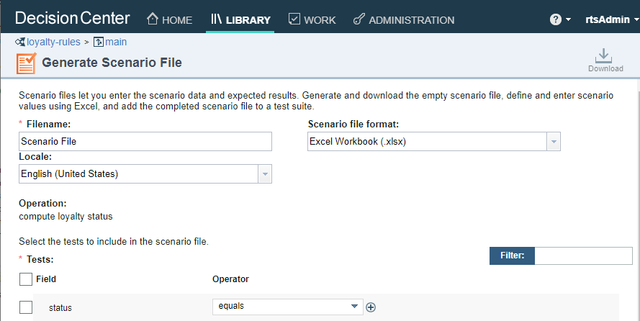
Live demo: decision validation

Slide 19



Two choices for decision authoring
Java model (XOM)
ODM Rule Designer
Standard decision service projects
ODM Decision Center
Standard decision service
ODM Decision Center
Decision model service

Slide 20
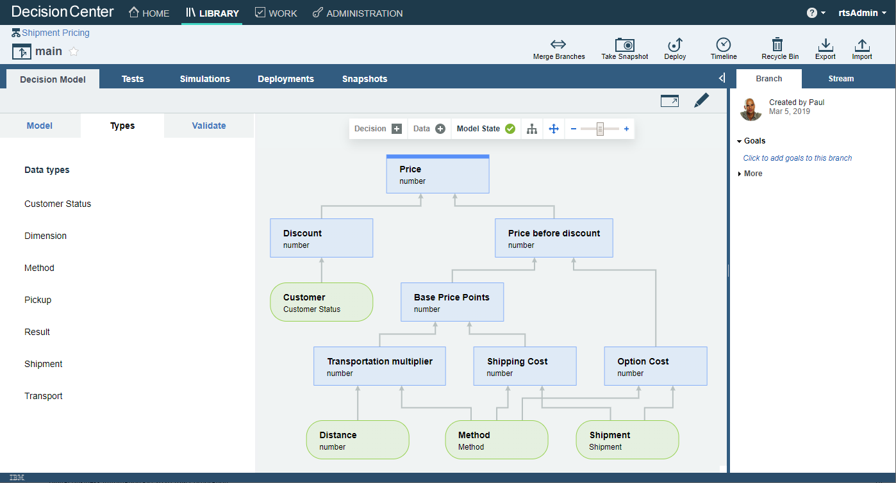
Building decision services with the Decision Model
No-code approach to building decisions services, based on DMN
Small set of concepts: data node, decision node, rule, decision table
Fit for purpose:
Top-down modeling approach
Simpler object models
Simpler decisions
See more information here

Slide 21
Live demo: build and deploy a decision model service

Slide 22




Decision service development methodology
Harvesting
Foundation
Building
Enhancement
Rule
Discovery
Rule
Analysis
Discovery,
Analysis
Decision design
Rule coding,
Unit test
Discovery,
Analysis
Rules Coding,
Unit test, Functional test
Continuous
Deployment
Integration
Tests
Change
Request
Rules Coding,
Unit test, Functional test
Regression
Tests
1 week
2 to 3 iterations of 1 week
n iterations of 1 week
1 day to 1 week
Rule Designer
Decision Center
Decision Center
Use ODM components as early as possible in your SDLC
Close collaboration between business analysts and rule developers
Build foundation: rule business object, rule flow, decision service operations, rule patterns using Rule Designer
Incremental ruleset implementation
Transfer to business users once the foundations are in place (Decision Center)
Build strong automated test suites
Continuously deploy RuleApp to target server and execute regression tests
Enhancement can be done in 1 day
Digital Business Automation - © 2022 IBM Corporation

Slide 23
Cloud Pak for Automation Bootcamp Hands-on lab! CP4BA ODM Lab - Mortgage.docx

Slide 24
Cloud Pak for Automation Bootcamp Lab solution walkthrough

Slide 25
Deeper dive topics
Projects organization
User and groups administration
Decision governance
Simulation
Deployment
DevOps
Reference architecture and methodology
Decisions + other Cloud Pak capabilities
Advanced topics

Slide 26
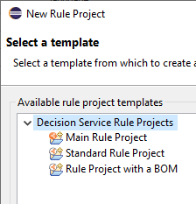
Projects organization
prequal-main
pq-validation-rules
pq-eligibility-rules
pq-risk-rules
pq-pricing-rules
prequal-bom
prequal-xom

Slide 27
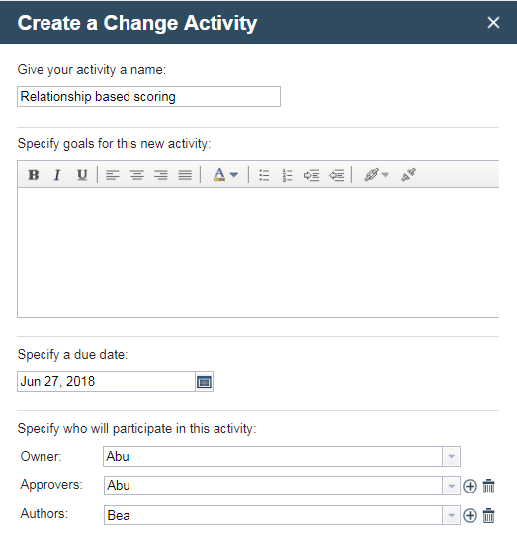
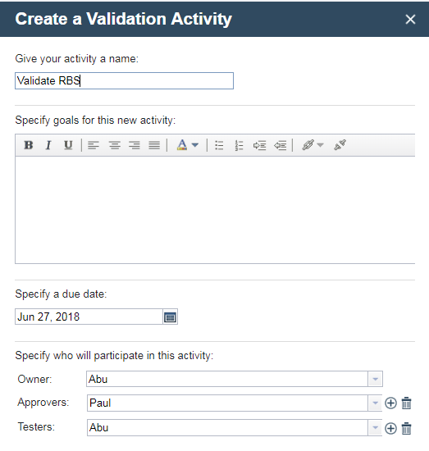
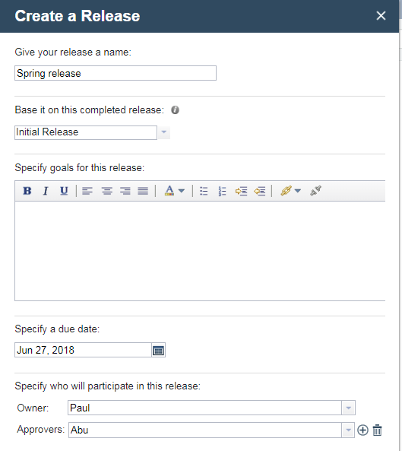
Decision governance framework in a nutshell
Change Activities
Update and unit-test
Validation Activity
Regression test
Release

Slide 28
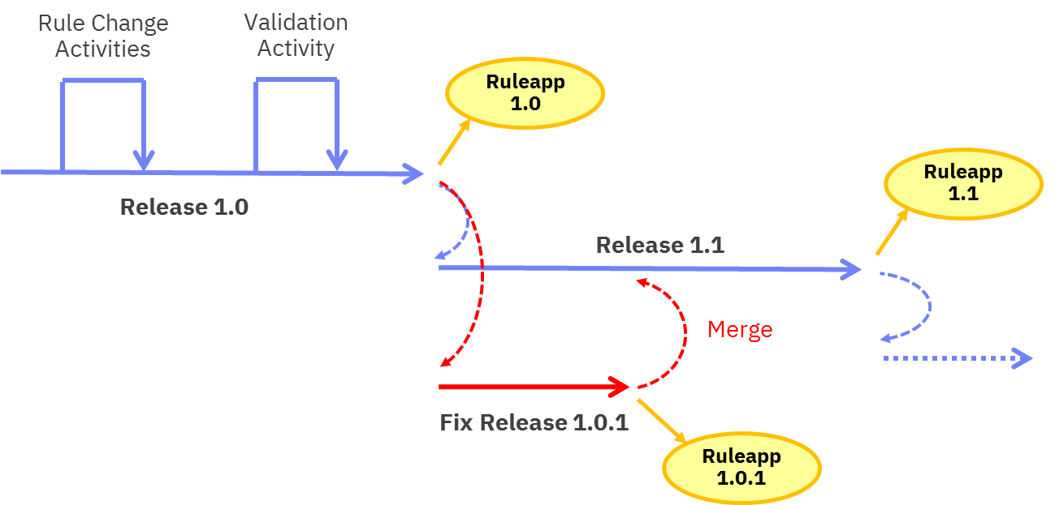
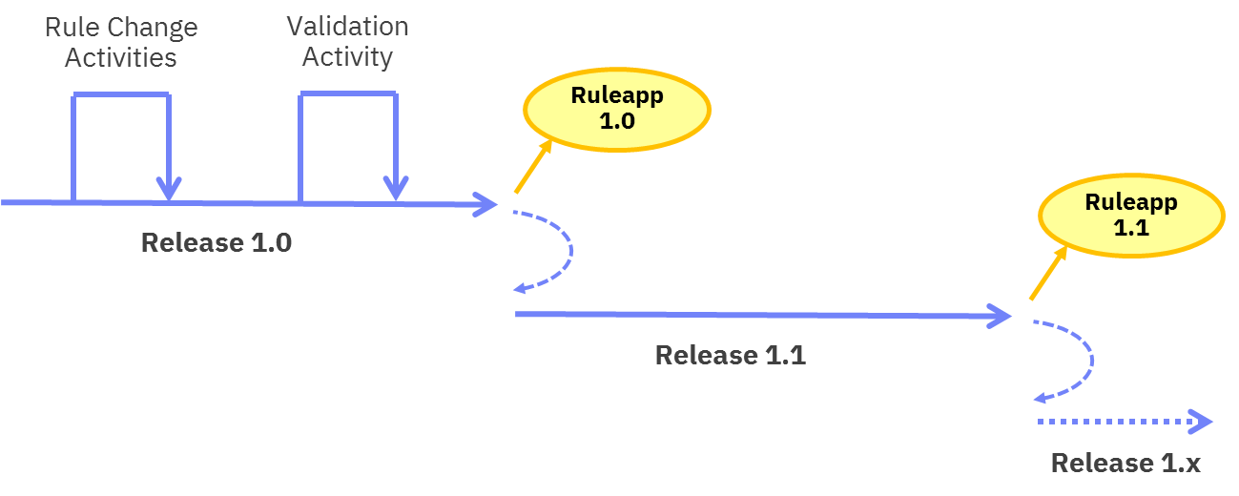
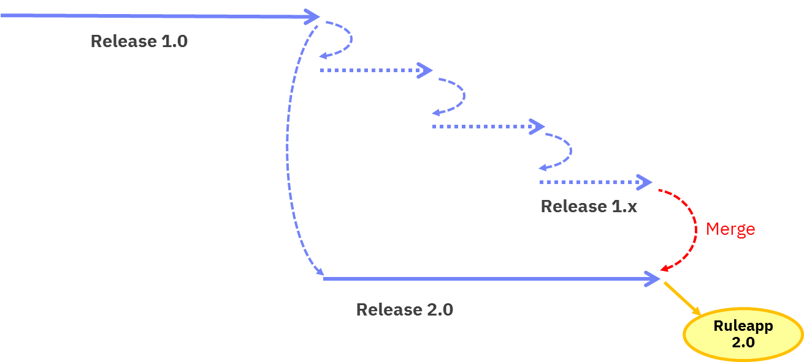
Change management: different release patterns
Hotfix release
Planned release
Parallel release

Slide 29
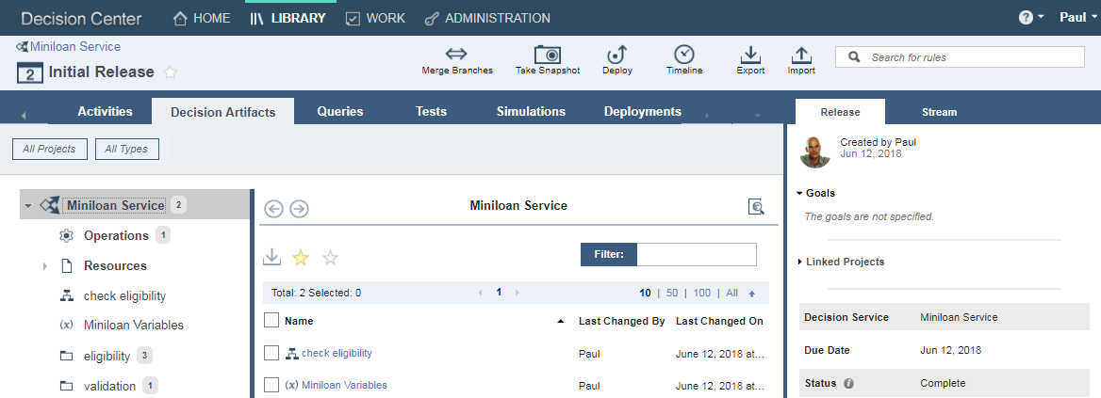
Decision Center business console
Manage change lifecycle
Manage decision services
Manage roles, access, permissions

Slide 30
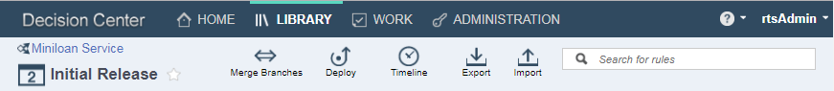
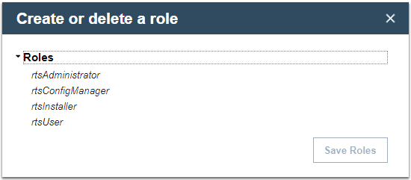
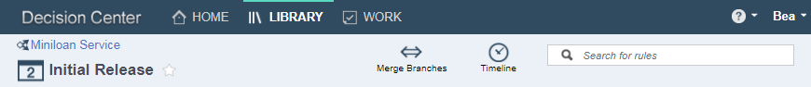
User roles

Slide 31
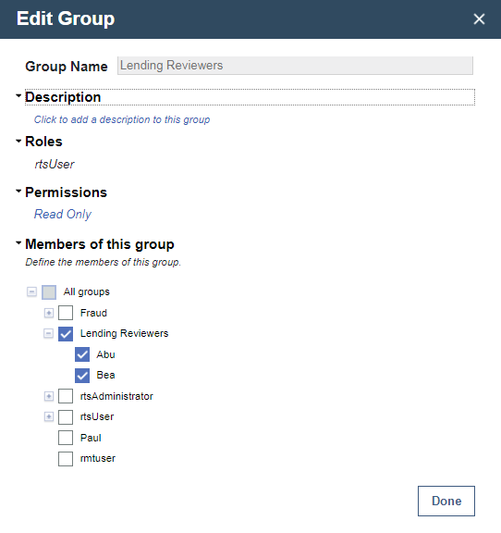
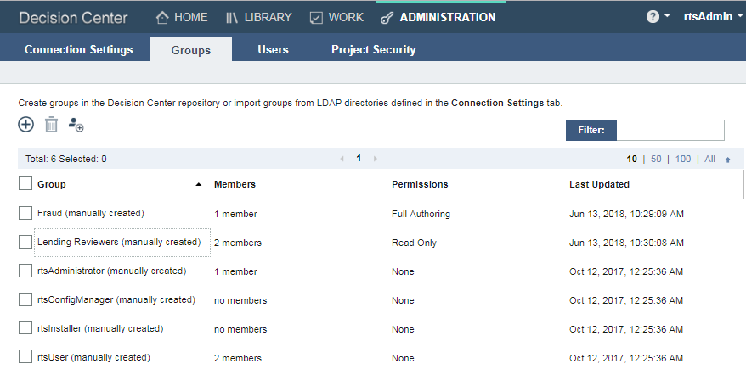
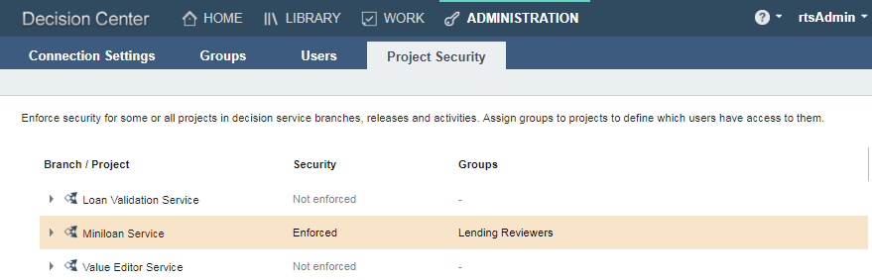
User groups

Slide 32
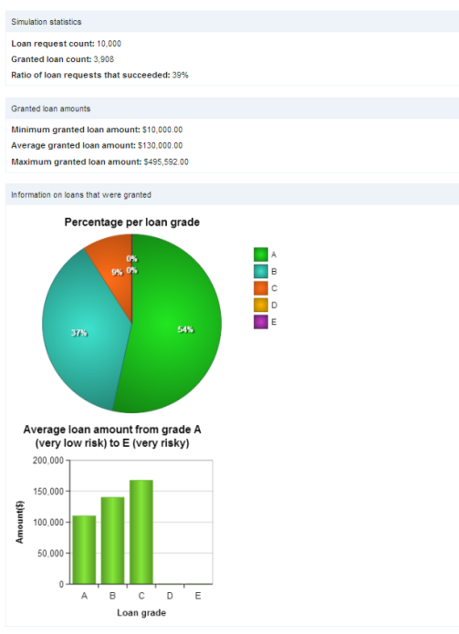
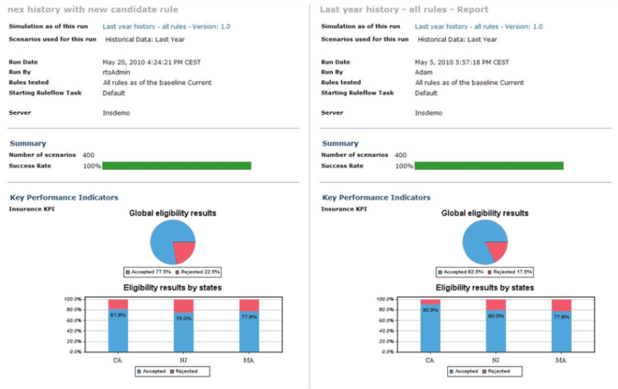
Simulations
Define Simulation
KPIs defined in natural language
Simulation data
Design Simulation Reports
Point and click report edition
Use of Graph objects for KPI rendering
Execute
Dedicated simulation environment
Isolated from production servers
Analyze
Side-by-side comparison

Slide 33
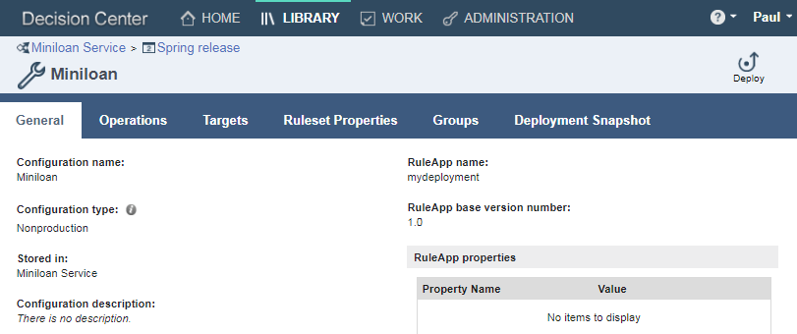
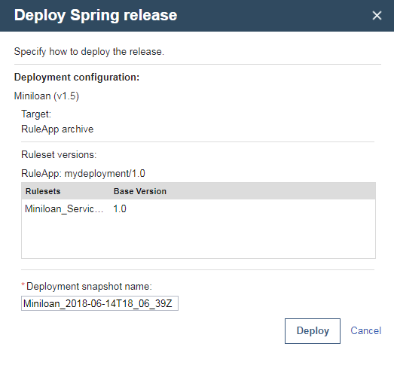
Deployment
Prepare deployments by defining Deployment Configurations
Select decision operations
Select target environment
Allow some configuration
Define permissions
User clicks – It’s deployed

Slide 34

DevOps tool chain integration
Key decision service management operations are exposed as REST APIs.
In particular:
Test
Build
Deploy

Slide 35




More DevOps options and entry points
Rule Designer
Decision Service
project files
Decision Service POM
RES Ant tasks
Build Command
RES REST API
Apache Maven
RuleApp archive
UCD plugin
Rule Execution Server

Slide 36

Decision logic complexity
BOM:
Flat set of data elements
No collections
Decision logic:
Simple sequential orchestration
Same rule pattern
Same category (e.g. validation)
BOM:
Complex hierarchy, with many classes
Includes object collections
Decision logic:
Complex orchestration (e.g. choices, exceptions, …)
Many rule patterns
Many categories (e.g. validation, inference, calculation)

Slide 37




Inference rule engine
ODM has 3 different engine algorithm: Fast Path (default), Sequential and Rete Plus (inference)
An inference rule algorithm is an optimized pattern matcher:
Rule condition patterns are matched to the objects in the Working Memory
Uses the Rete algorithm
https://en.wikipedia.org/wiki/Rete_algorithm
Usage:
Stateful rule engines
Produce new knowledge, build artifacts
Working Memory
Agenda
Rule Engine
Objects available to the engine
Rules fireable by the engine

Slide 38
Inference: truck and drivers example
Ruleset
AssignDriver(T,D):
if
there is a truck T without a driver and
there is a free driver D
then
assign driver D to truck T
Working Memory
working memory has changed
truck1(no driver)
truck2(driver1)
driver1(truck2)
driver2(free)
driver3(free)
1
3
rule is fired
Agenda
AssignDriver(truck1,driver2)
AssignDriver(truck1,driver3)
working memory is updated
agenda is updated
4
2
agenda
empty ?
no
yes
Notes:
Facts in the working memory are instances of java classes
The condition part of the rule identifies all instances verifying given conditions
The action part of the rule can:
Create new instances
Modify existing instances
Execute actions
Two possible strategies:
Execute all the rules in the agenda before updating the agenda
Update the agenda after each rule execution
The latter is preferred because it won't leave the system in an incoherent state:
Example:
Rule: "If there is a truck without a driver, and a free driver, assign the driver to the truck“
Facts: one truck without a driver and two free drivers
Result: with the first strategy, the two drivers will be assigned to the truck.
To the pure logician, this won't make sense (the fact that a different control strategy might leave the system in an incoherent state). But two things to keep in mind: we have a situation with non-monotic logic because rule execution changes objects states. What is true now may no longer be true in the future. In a classical logic system

Slide 39

Pattern matching for iteration
This rule records every row that contain the name of a given state (e.g. California) in all the tables of a document.
It is equivalent to 6 nested for loops.
document
page
table
row
cell
line
word

Slide 40
Existential conditions
Used to check whether one or more business terms of a certain type exist in a set of data.
if
there is one customer where the category of this customer is Gold
then
...
if
there is no customer where the category of this customer is Gold
then
...
This rule checks whether there are more Gold customers than Silver customers
definitions
set 'silver customers' to all customers where the category of each customer is Silver;
set 'silver count' to the number of 'silver customers'
if
there are at least ('silver count' + 1) customers where the category of each customer is Gold,
Then
...
https://en.wikipedia.org/wiki/Quantifier_(logic)

Slide 41
Rules as a general-purpose programming language
if
you have an object model
you have validations or inferences to perform on model instances
then
you can use an ODM rule-based implementation
Examples:
Rules to validate Excel spreadsheets content using Apache POI
Rules to validate and navigate BACA JSON: https://github.ibm.com/pberland/lcr-baiw-poc
Rules to validate PDF forms using Apache PDFBox: https://github.com/pberlandier/odm-with-pdfbox
Rules to validate rules: https://github.com/ODMDev/odm-transformation-advisor

Slide 42
Many possible decision deployment targets
ODM on Cloud
(SaaS)
ODM for Developers
ODM Server
on WAS (VM)
ODM runtime
on OCP and CNCF K8s
ODM Standard for z/OS
RES
RES
RES
RES
RES
Decision Center

Slide 43

Installing Rule Designer
Download and install Eclipse 2020-06 and install the Rule Designer plug-in
See documentation at https://www.eclipse.org/downloads/packages/release/2020-06/r
Import Decision Center (and OpenID server) security certificates to Rule Designer
-Djavax.net.ssl.trustStore=truststore.jks
-Djavax.net.ssl.trustStorePassword=changeit
-Dcom.ibm.rules.authentication.oidcconfig=./OdmOidcProvidersRD.json

Slide 44
Rule-based decisions, plus ML-based decisions
Rules and ML are not exclusive. They are complementary over a spectrum.
ODM
Business Rules & Events
ADM
Predictive Analytics & Optimization
Situations
Validation
Eligibility
Compliance
Calculations
Risk
Customer opportunity
Classification
Segmentation
Mathematical optimization
Event patterns
Know-how
Regulations
Explicit formulas & predictive sensitivity models
Explicit assessment & predictive risk models
Relationship information & predictive propensity models
Descriptive & predictive models
Linear programming

Slide 45

Reference Architecture
https://www.ibm.com/cloud/architecture/technical-decision-points/business-automation

Slide 46
References
Installing Rule Designer: Knowledge Center
Architecture Center: https://www.ibm.com/cloud/garage/architectures/businessDecisionAutomationDomain
Videos, product tours: https://www.ibm.com/demos/collection/IBM-Operational-Decision-Manager

